Slide 1

HackRF+Portapack H2
Internal speaker test

Slide 2
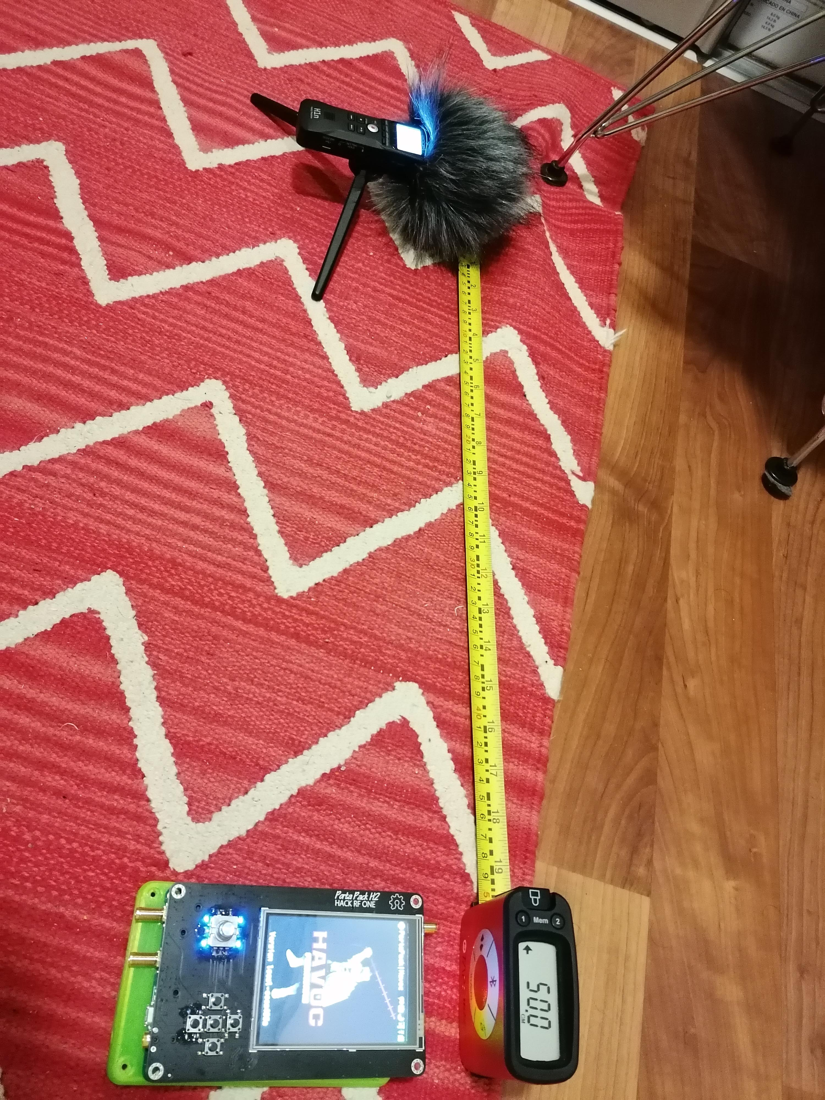
Test environment
Zoom H1n recorder
Placed to the left, at 50 cm
All autolevel/low cut disabled
WAV 96k 24bit
Room 4x8x2 mt aprox

Slide 3
Background sound

Slide 4
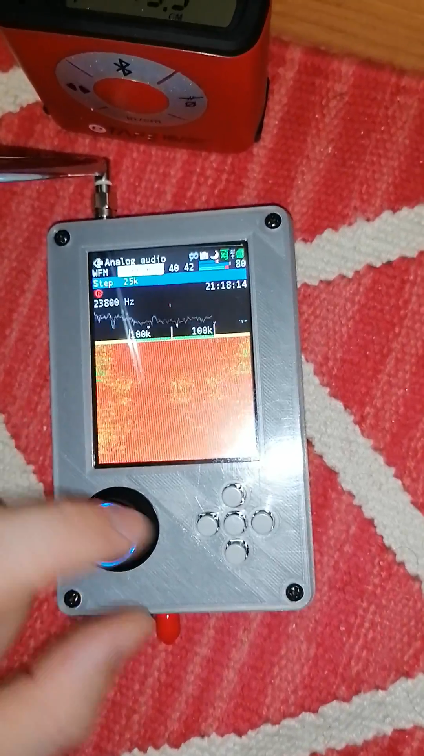
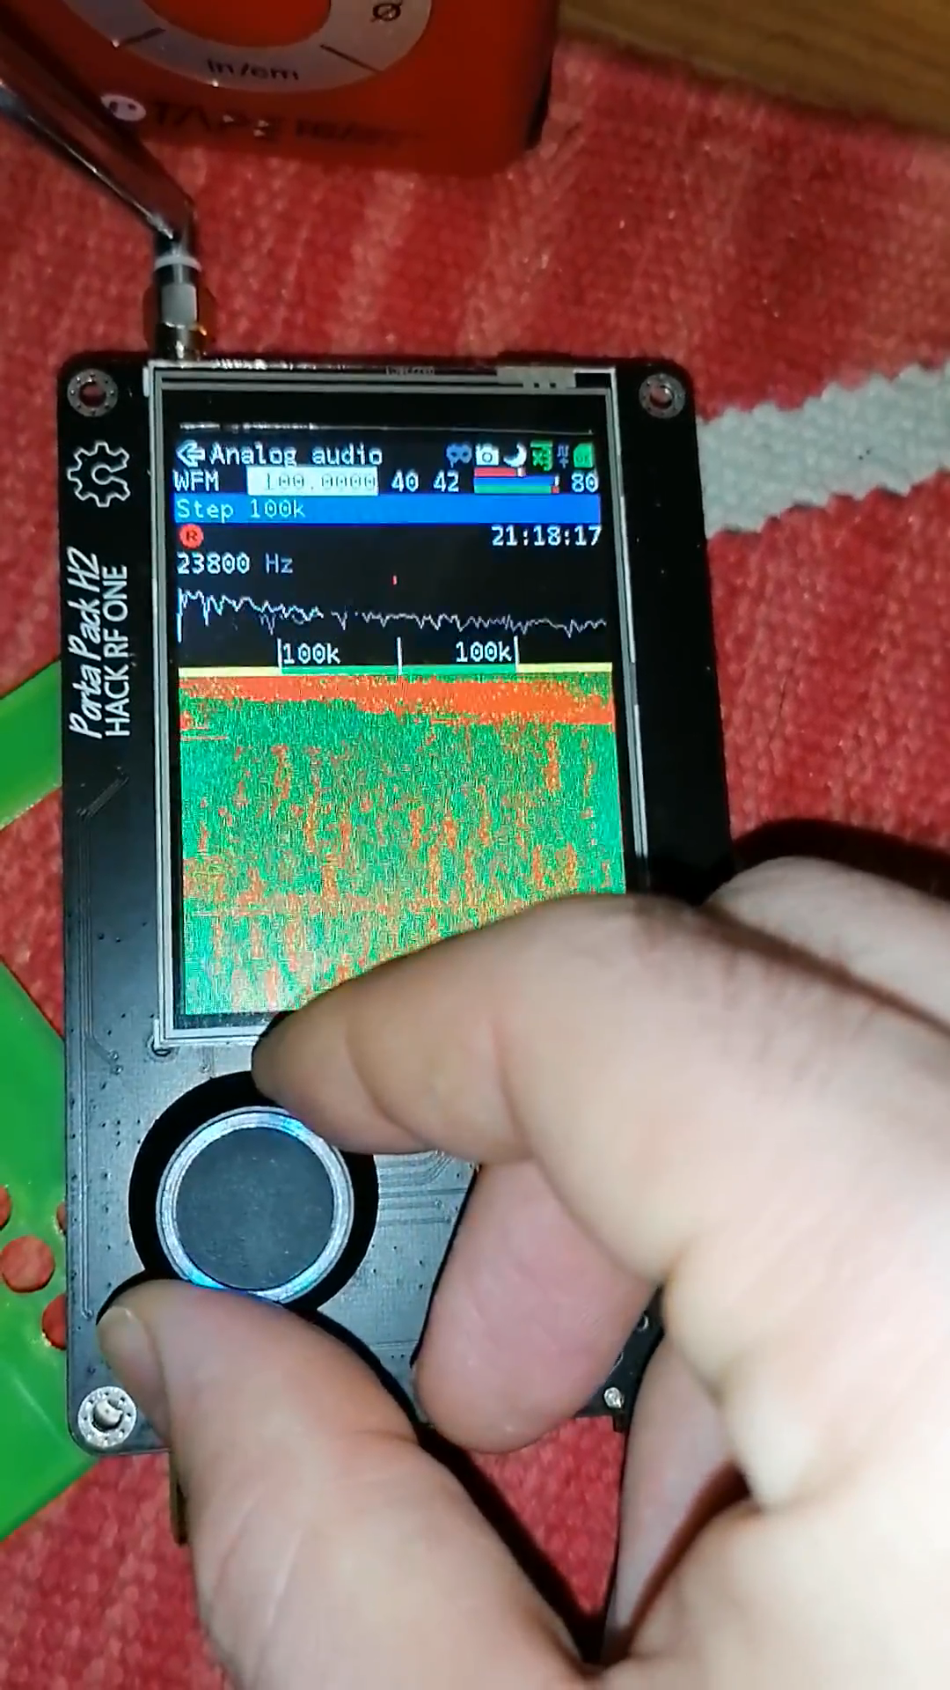
Recording comparison
Noise (volume 80)
Noise (volume 99)
Epic Sax (volume 80)

Slide 5
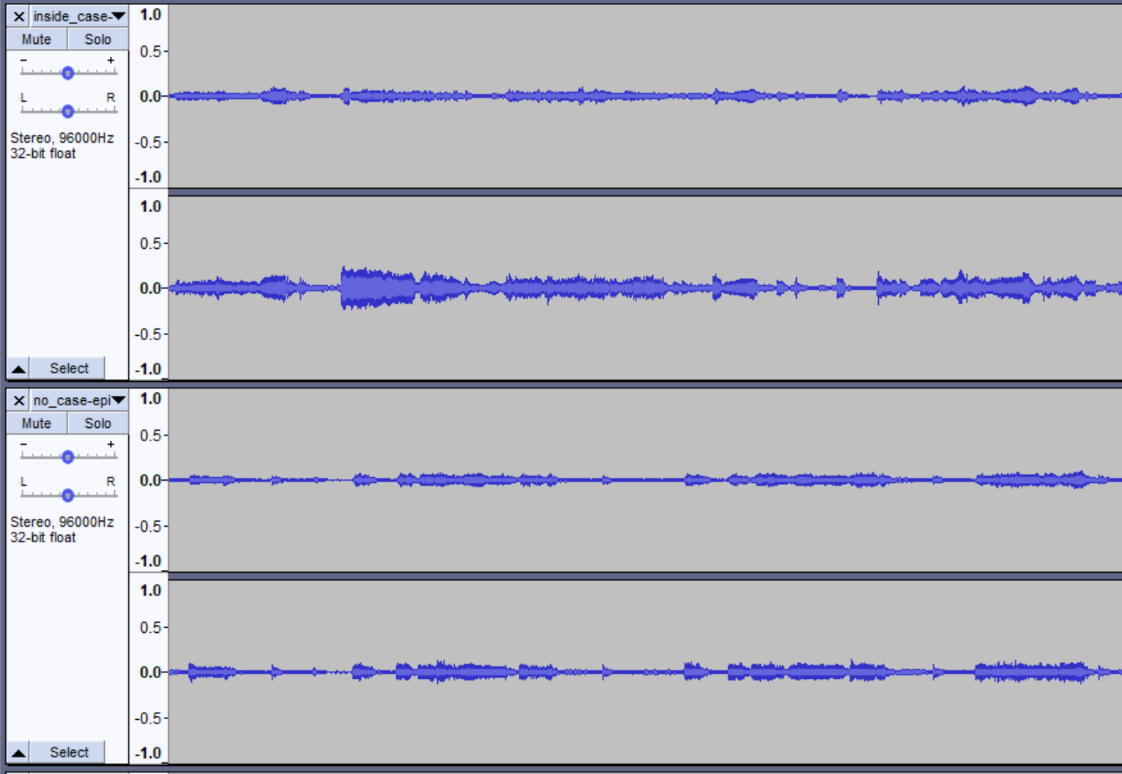
Results
Sound becomes more directional inside the case
Most of the sound comes from the screen

Slide 6
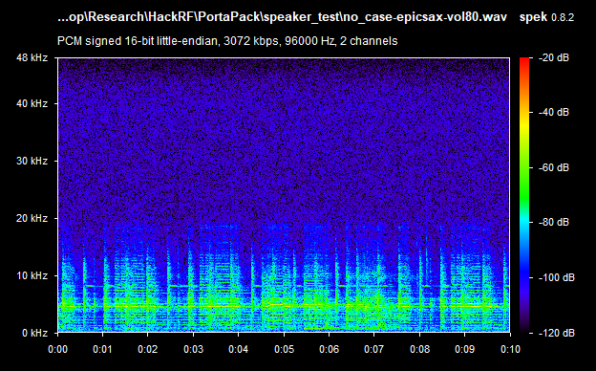
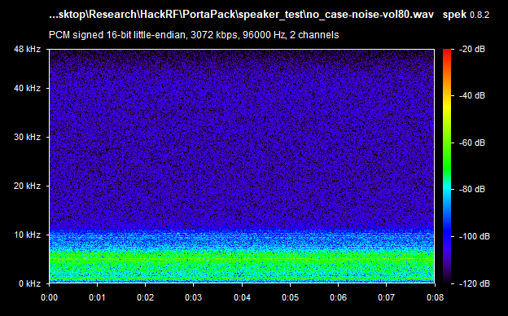
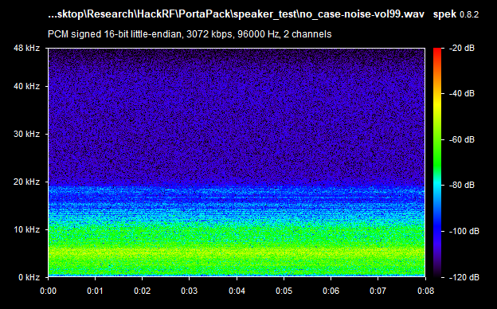
Results
Loudness drops inside the case, as expected

Slide 7
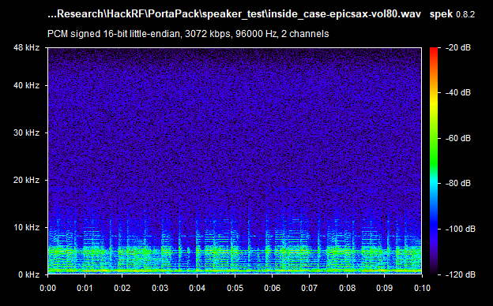
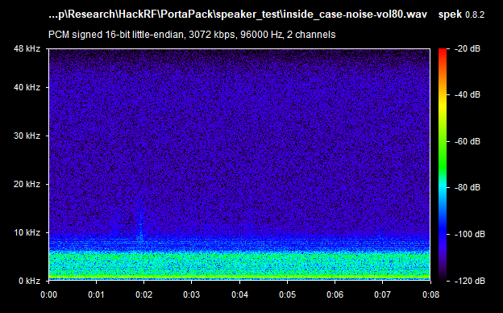
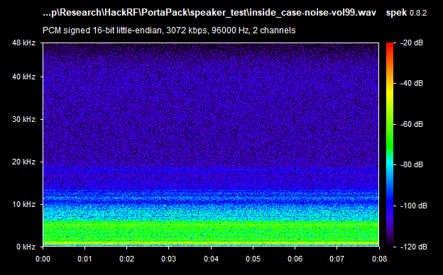
Results
Loudness drops inside the case, as expected

